Slide 1
A Multimodal
Attention Tracking
in HRI for Industrial Robots in tasks
Robot is able to track operator’s attention through the vision and oral input during the HRI.

Slide 2

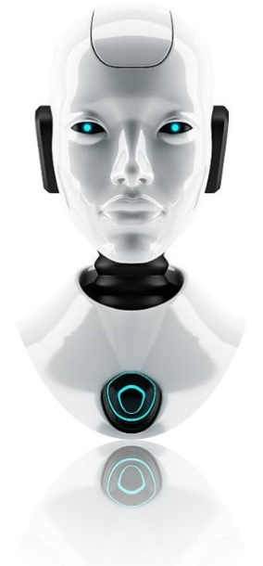
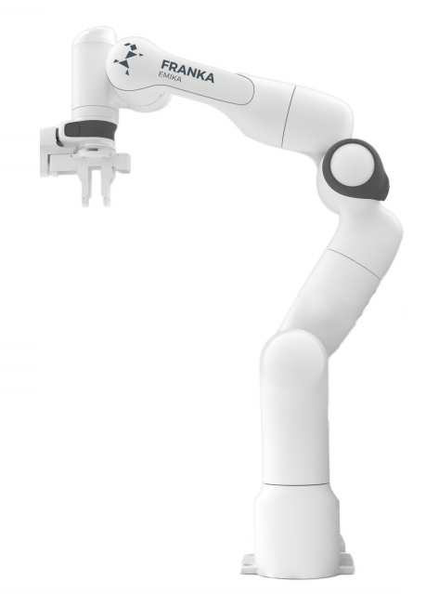
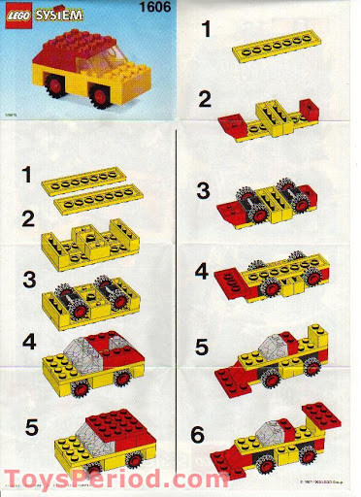

Workflow
Visual information of the Operator’s eyes/head position
Camera
Operator
https://www.google.com/url?sa=i&url=https%3A%2F%2Fwww.pinterest.dk%2Fpin%2F63191201000733517%2F&psig=AOvVaw3opz-MQ_7thWgK4wXyb635&ust=1615905908680000&source=images&cd=vfe&ved=
Max
Franka Robot
Action/State
Oral instruction
Attention Tracking
NN for Conversation
DB or Script run in Max
Response
NN for Vision
Action Selection
Max will keep tracking the operator’s attention by analyzing what operator says.
Max will keep tracking the operator’s attention by monitoring operator’s head and eye movement.
…
Assembly Tasks

Slide 3
Actor
Hey Franka, how are you doing?
example
Action: Speak
Non-task related conversation
Task-related oral command
Can you start to assembly?
example
Input of Max
Operator
example
Operator changes gazing direction
Action: Movement
Eye movement
Head position
Body gesture
Operator move head away
example
Input of Max
Need to discuss
where should the camera be installed
Action: Co-Assembly
Lego
Phone
TBC
Need to discuss
Which task it can work on?

Slide 4
Actor
Need to discuss
Grounding intents
Action: Understand
Recognize the operator’s intent
Recognize the command
Need to discuss
Grounding robot skills
Max
Max verifies if what operator says makes sense or not.
Action: Monitor
Max monitors the change of the eye and head position of the operator
Tracking the operator’s intent
Analyzing the dialogue context
Tracking the operator’s eye/head
Sure, l will do the assembly now.
example
Action: Generate Action
Need to discuss
the communication between Max and Franka , as well as the data format
Generate the Cov. Response
Send the command to the robot
Input of Franka

Slide 5
Actor
Action: Query/Mapping
Query the oral instruction
Grounding the oral command
Franka Robot
Need to define the states and the data format
Action: Update
Update the state of the task
Report the state of the system
Input of Max
Action: Co-Assembly
Lego
Phone
TBC

Slide 6
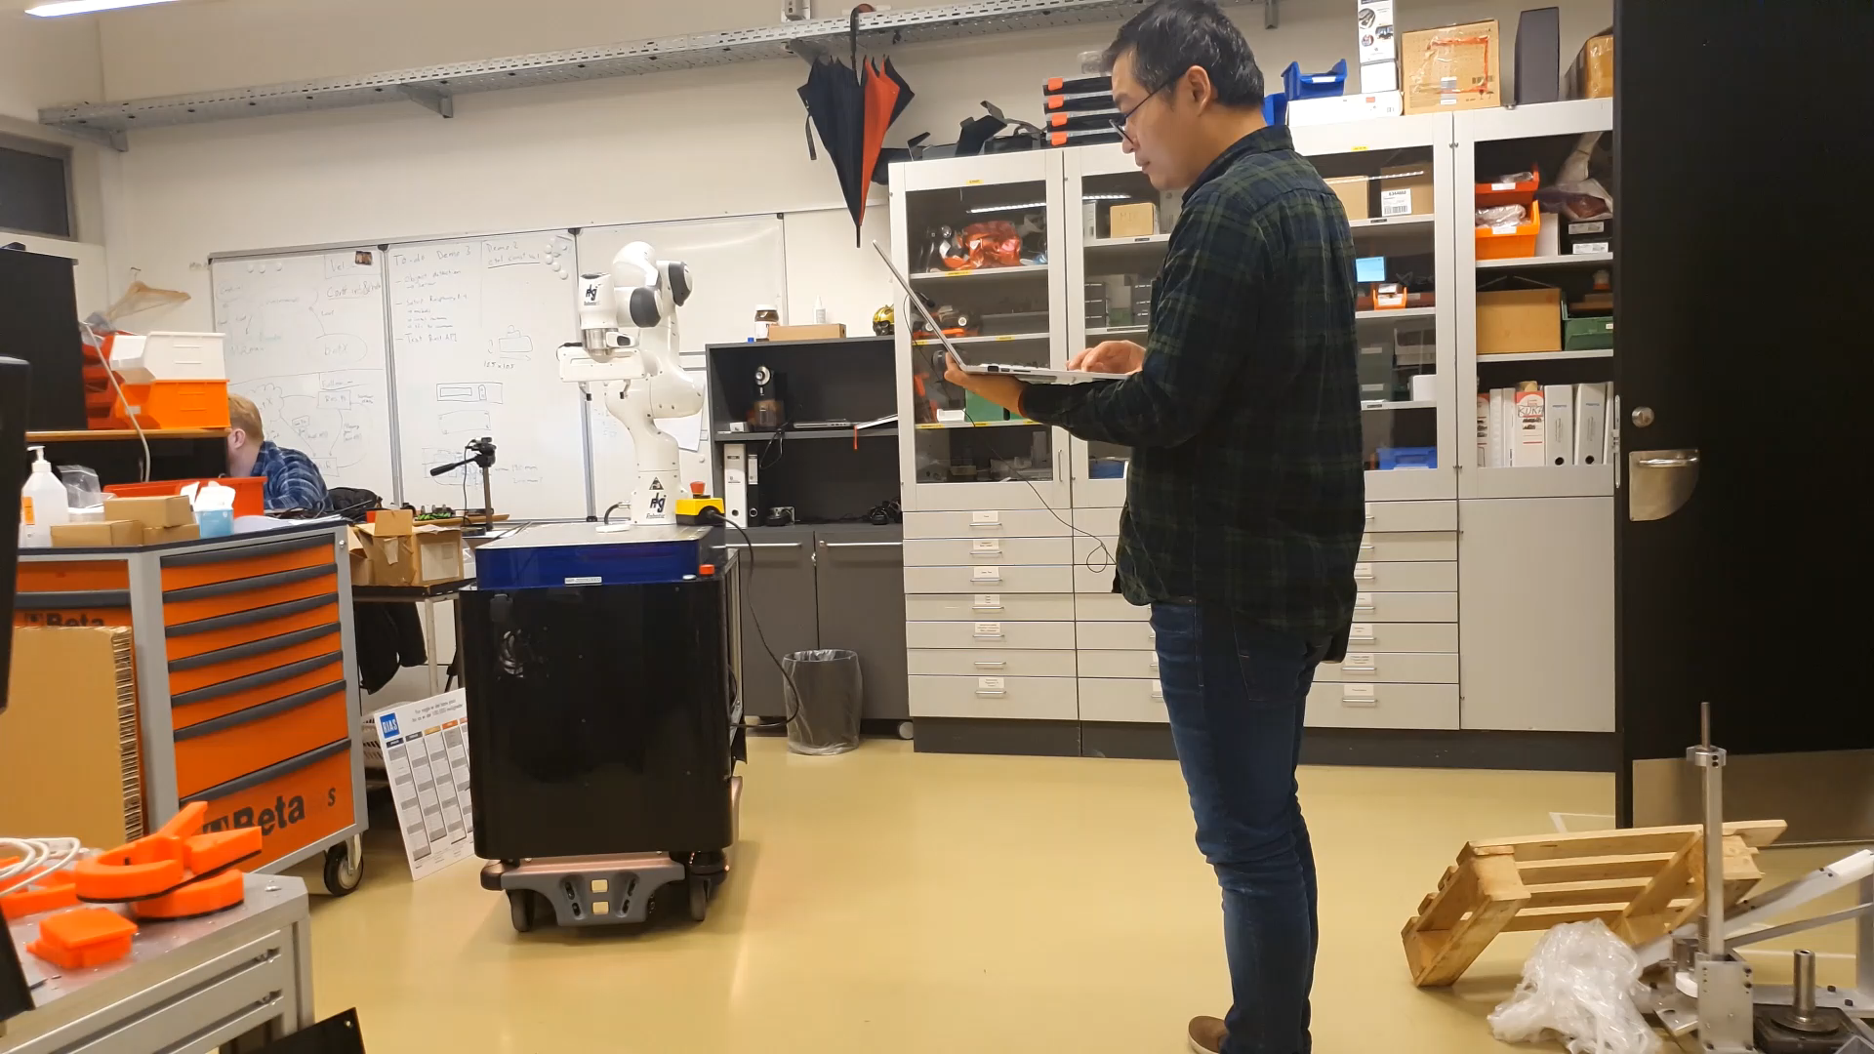
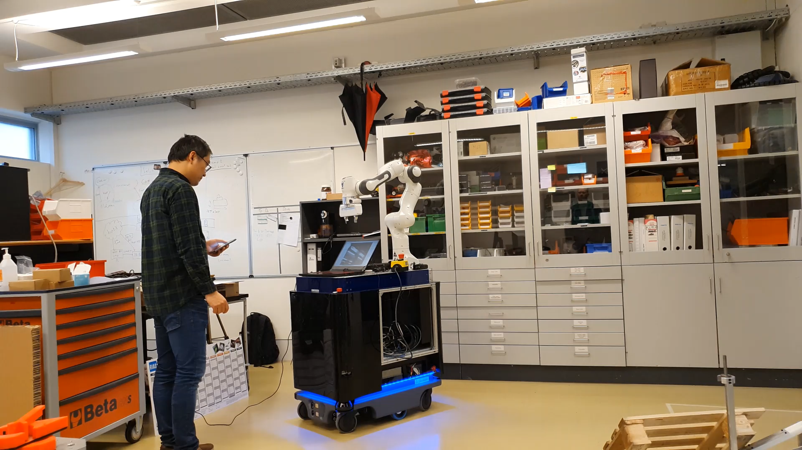
Demo – previous work
Clip one: Intent switch
Clip two: head pose change
Description: tracking the attention by monitoring the intent switching
Description: tracking the attention by monitoring the head pose

Slide 7
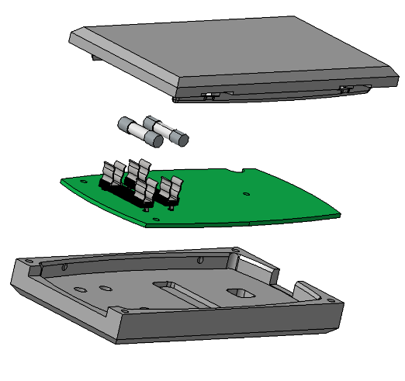
Case – Phone Assembly (1)

Slide 8
Scenario Description
Dummy Mobile Phone
Parts
Top Cover
PCB
Fuses
Bottom Cover
Feature
Color of Cover
White
Blue
Black

Slide 9
Scenario Description
Assembly Tasks
Task one:
FE helps operator to assembly phone
Focus on - bring part to the operator
Task two (tbc)

Slide 10
Scenario Description
FE Skill
Grasp part (fix location)
Deliver part (fix location)
Other
Report task state
Pause/Continue task
Model Capability
Vision
Identify category ()
Location (?)
Recognize color
Language
Recognize Intent
Infer command

Slide 11
Task related Built-in Intents
Intents
Example utterances
TaskCheck
Hey, what are you working on?
Hey, are you free now?
Max, give a white bottom cover.
Max, I need a fuses please
Max, can you grasp a PCB for me?
BringPart
Max, please wait for a second.
Stop right now, please.
Hold on a second
PauseTask
Max, please continue.
Ok, let’s start it.
Max, keep working
ContinueTask

Slide 12



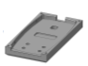
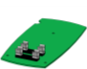
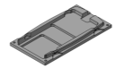
Example Scenario
Intent: BringPart
Object: fuses
Color: None
1
Hey Max, please give me a fuses.
Action
Object identification
Grasp
2
Sure, give me a second.
Action
Deliver
3
Here you are.
4
Basic Assembly
Thanks!

Slide 13
Example Scenario
Intent: BringPart
Object: cover
Color: None
1
Hey Max, please give me a cover.
Action
pausetask
2
Sure, but which color you need.
Intent: BringPart
Object: fuses
Color: None
3
Action
Object identification
Grasp
Deliver
I need a fuses please.
4
Intent: BringPart
Object: cover
Color: blue
Sorry, do you still need me to give you a cover?
Attention based Assembly
5
6
Yes, give me the blue cover first. Thanks.
Here you are.

Slide 14
Tasks

